Slide 1
PROJECT TITLE Disease Prediction Using Machine Learning and Big Data
Team Details :-
1. Rathlavath Rajesh (20EG105401)
2. Gajjela Stevenson (20EG105412)
3. Neelagiri Chandradeep (20EG105429)
Project Supervisor :-
Ms. G. Sreeja

Slide 2
Introduction
The "Disease Prediction Using Machine Learning and Big Data" project is a cutting-edge initiative aimed at harnessing the power of advanced technology to enhance disease prediction, ultimately leading to more effective healthcare management. This project combines the expertise of data scientists, healthcare professionals, and technology specialists to create a comprehensive system for disease prediction and prevention.
We will need comprehensive healthcare data sources like electronic health records and genomic data. Additionally, we'll require a robust big data infrastructure and access to cloud computing resources for efficient data processing and scalability. Collaboration with healthcare experts and adherence to data security and privacy standards are crucial.
The application of disease prediction using machine learning and big data is transformative across healthcare. It empowers early disease detection, personalized healthcare, and efficient resource allocation. Healthcare professionals use it for decision support, while public health benefits from outbreak prediction and management.

Slide 3
Literature
Author(s) | Method | Advantages | Disadvantages
P. Groves, B. Kayyali, D. Knott, and S. van Kuiken | The ‘Big Data’ Revolution in Healthcare: Accelerating Value and Innovation | Makes it easier to collect and analyze information from multiple sources | Data privacy and security issues and concerns
M. Chen, S. Mao, and Y. Liu | ‘‘Big data: A survey’’ Mobile Network Application | The technological evolution emerges a unified Internet of Things network | Increases complexity including new challenges and requirements demanding for new approaches
P. B. Jensen, L. J. Jensen, and S. Brunak | Mining electronic health records: Towards better research applications and clinical care | Clinical data represents a data source that has greater potential | Broad range of ethical, legal and technical reasons
M. Chen, Y. Ma, Y. Li, D. Wu, Y. Zhang, and C. Youn | Wearable 2.0: Enable human-cloud integration in next generation healthcare system | More reliable and intelligent services | User needs to wear the devices for extended periods of time to get accurate results
D. W. Bates, S. Saria, L. Ohno-Machado, A. Shah, and G. Escobar | ‘‘Big data in health care: Using analytics to identify and manage high-risk and high-cost patients’’ | Opportunities to use big data to reduce the costs of health care reform | Initial considerable expense

Slide 4
Problem Statement
Disease Prediction by Machine Learning Over Big Data From Healthcare Communities
Objective:-
With the increasing number of deaths due to diseases, it has become mandatory to develop a system to predict effectively and accurately. The objective of our project is to develop a robust and accurate disease prediction system by using machine learning and Big Data analytics. Using large amounts of medical data, including patient records, genetic information, and environmental factors, we aim to create predictive models that can identify potential disease risks and outcomes. Our goal is to enhance early diagnosis, improve treatment planning, and ultimately contribute to better healthcare outcomes by providing clinicians and individuals with valuable insights into disease prevention and management.

Slide 5
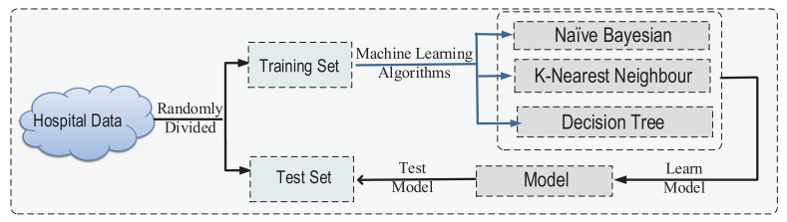
Proposed Method
The hospital data is randomly divided into training and testing sets of data. The machine learning algorithms such as Naïve Bayes, K-Nearest Neighbors, and Decision Tree and their models are built based on this data. These models are then trained extensively using the allocated training set of data. These trained models are then used to handle the test set of data and make accurate predictions about the diseases based on the data given. Finally, these predictions are displayed to the user.

Slide 6
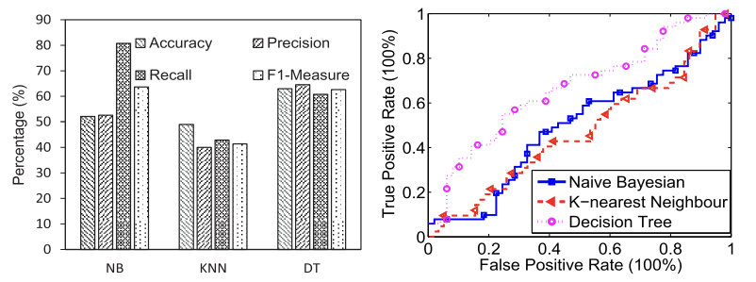
Proposed Method
This prediction is basically done with the help of four different algorithms which are Decision Tree, Random Forest, KNN and Naïve Bayes. After user enters all the symptoms then he/she needs to press the buttons of respective algorithm, for example there are 4 buttons for 4 algorithms, if user enters all symptoms and presses only Random forest’s button then the result will be provided by calculating using only that algorithm.
KNN relies on similarities between patients, Decision Trees create interpretable decision rules, Naïve Bayes handles probabilistic relationships, and Random Forests enhance prediction accuracy through ensemble learning. This comprehensive method holds great promise in revolutionizing healthcare by enabling early and precise disease diagnosis and treatment planning.

Slide 7
Project status
S.NO | Functionalities | Statues
1 | Design and flowchart | Completed
2 | Algorithm selection | Completed
3 | Data acquisition and integration | Completed
4 | Data preprocessing | In progress
5 | Model development | In progress
6 | Model evaluation | In progress
7 | Cloud computing | Not yet started
8 | Big data infrastructure | Not yet started
9 | Maintenance | Not yet started

Slide 8
References
P. Groves, B. Kayyali, D. Knott, and S. van Kuiken, The ‘Big Data’ Revolution in Healthcare: Accelerating Value and Innovation.
M. Chen, S. Mao, and Y. Liu, Big data: A survey, Mobile Network.
P . B . Jensen , L . J. Jensen, and S. Brunak , “Mining electronic health records Towards better research applications and clinical care.”
M. Chen, Y. Ma, Y. Li, D. Wu, Y. Zhang, and C. Youn , “Wearable 2.0: Enable human-cloud integration in next generation healthcare system.”
D. W. Bates, S. Saria, L. Ohno-Machado, A. Shah, and G. Escobar, ‘‘Big data in health care: Using analytics to identify and manage high-risk and high-cost patients”

